Slide 2



THE QUALITY OF GOOGLE SEARCH RESULTS
2023
about basic scientific terms in different languages and places

Slide 3

INFECTION
זיהום
عدوى
FERTŐZÉS

Slide 4





USA
Japan
ATLANTIC OCEAN
PACIFIC OCEAN
PACIFIC OCEAN
INDIAN OCEAN

Slide 5





research question
The geographical location
Is there an effect of geographic location on different measures of Google's repeated search results for different scientific terms
United Kingdom
Canada
Germany
Japan
ATLANTIC OCEAN
PACIFIC OCEAN
Mexico
Philippines
PACIFIC OCEAN
INDIAN OCEAN

Slide 6

previous theories
Your Chance of Finding Quality Scientific Information on Google Depends on the Language You Search In
Science Communication in Multiple Languages Is Critical to Its Effectiveness

Slide 7

Innovation
compared to two parallel studies
Examine new dependencies, such as quality versus accessibility
Examining the results in relation to the effect of geographic location, which has not been studied so far.
delving into a wider variety of languages ​​and their gaps in the scientific aspect.

Slide 8


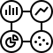


Data Overview
61
2916
4
Features
row
Types
Conspiracy Theories
Canonical Scientific Issues
16
402
Novel Science and Technology Issues
Countries
Scientific terms
Socio-Scientific Isuues

Slide 9


OUR Findings

Slide 10

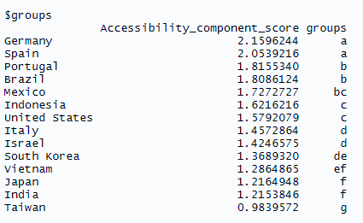
B
C
Step 1- Least Significant Difference (LSD)
A
D
E
G
F

Slide 11
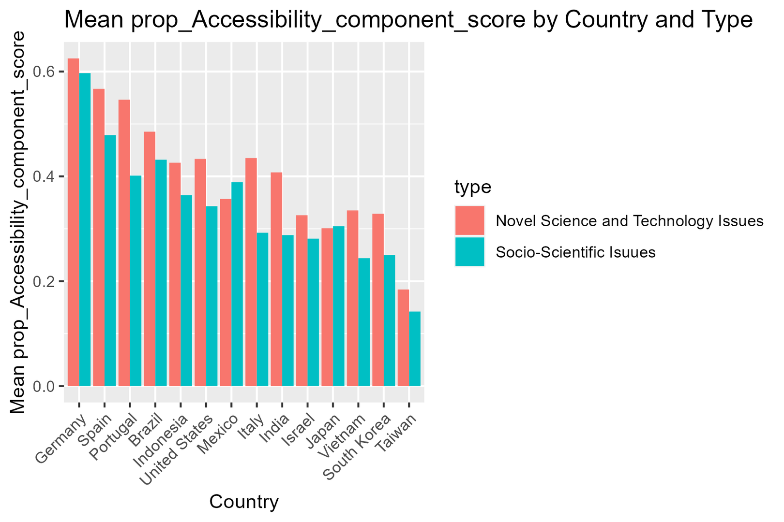
Step 2- Anlyze the trends behind the groups

Slide 12


Regression model

Slide 13
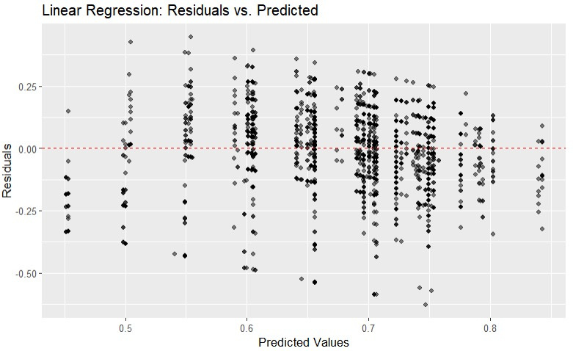
Model Checking
residuals
Residuals distributed randomly around 0
With no visible pattern along the x or y axes

Slide 14
adj r squared
r squared
0.3
0.2747
0.278
0.1597
0.2056
0.2088
0.2
0.156
0.1
0.0726
0.0754
0
Conspiracy Theories
Socio-Scientific Isuues
Canonical Scientific Issues
Novel Science and Technology Issues

Slide 15

end
conclusions
proof of the gap
The study contributed as follows:

Slide 16
end
conclusions
proof of the gap
The study contributed as follows:
01.
Using LSD we proved that there is a difference in the various indices between the countries

Slide 17
end
conclusions
proof of the gap
The study contributed as follows:
01.
Using LSD we proved that there is a difference in the various indices between the countries
02.
With the help of a regression model we were able to know with the help of the site's accessibility its quality

Slide 18

end
conclusions
proof of the gap
The study contributed as follows:
01.
Using LSD we proved that there is a difference in the various indices between the countries
02.
With the help of a regression model we were able to know with the help of the site's accessibility its quality

Slide 19
THANKS FOR LISTENING
2023

Slide 20

ליאור וקנין
אוראל ג'רהיאן
איילת - השחר כהן
צוף לחן

